Slide 1
Toward Tests of Machine-assisted Science
Paul Cohen, scribe

Slide 2
Can machines accelerate/enhance science?
Think about science at three levels: Strategies, tactics, procedures
Ask what scientists do and imagine substituting machines
What is the role of metamodels in effecting this substitution
How would we know whether the machines are doing a good job, given the expressivity of the metamodels?

Slide 3
Strategies
Exploratory – what is it? characterize a new phenomenon, domain, things you can do with a new kind of microscope (primarily descriptive)
Explanatory – how does it work? Assign cause;
Extension/elaboration::narrowing/reducing – extend the scope of a model, flesh it out, parsimony;
Reformulation: Same problem, but import a new way of framing it (often from a different field); metaphor and analogy;
Figure out the proper context for a model, boundary conditions, by domain;
Engineering – how to make it do something? Optimize, design interventions, ... tradeoffs between effects (as predicted by models);
Comparative/Review – is this model/theory "better" than another, state of the art, meta-analyses, consolidation of results, subsumption/generalization of one model by another, tradeoffs between models;
Validation – is the model "right" in predictions, parsimonious, computable, explainable, accords with other models, etc.

Slide 4
TACTICS
Suppose your model says (among other things) p = X influence Y
If I care about Y, which Xs should I look at?
What evidence would indicate p?
On what does p depend?
By which mechanism(s) does p?
How to quantify uncertainty that p?
How to reduce uncertainty that p?
Do data tell us that p?
Parameterize p given data
Who else says p and what other models of p are there?
What happens to p if...(various interventions)
Optimize some outcome that depends on p?
What is the dynamics of p?
Can p account for stuff in a new domain
How would I modify p to bring it into correspondence with reality?
Characterize attributes or behaviors of systems (not just about a piece of a system, such as p); e.g., oscillatory behavior, linear response, etc.

Slide 5
Planning/workflows/procedures (examples)
Procedures are common ways to implement scientific tactics; for example:
Strategic decision: extend a model
Tactical decision: modify the model to handle cases it couldn't before
Procedure: 1) get the model from a repository, 2) get the "standard" data, 3) modify the model (e.g., add a term), 4) run it on the standard data, 5) add new data, 6) then assert "my modified model handles the standard data as well as the old data but also handles the new data."

Slide 6
What can machines do?
Can machines implement procedures and workflows? Yes!
Can machines implement tactics? Probably some of them
Can machines implement strategies – it's a qualitatively different level of description of science, we're not sure.

Slide 7
What is the role of metamodels in what machines can do for scientists?
Objects and methods analogy: Tactics are methods on models (objects)
E.g., object= linear regression; instance = particular dataset; methods: fit, R^2, analyze residuals, suggest other Xs...
But at a metalevel "fit" doesn't mean only OLS, it might mean other estimation procedures; same with "suggest other Xs", etc.
Principle: The metamodel language must allow you to express what you want the model to optimize (and constraints)
E.g., Comparing two models: equivalent? in which parts of input parameter space do they agree? parsimony/efficiency/..
E.g., By which mechanism does X influence Y? "Open the box" to find direct causes, turn indirect relations into direct causal chains

Slide 8
Back to the layers (at the level of tactics and procedures some of this is already done)
models
methods
object: linearity, interaction terms
explain y in terms of x's
how well does x_i explain y
y ~ w1 x1 + w2 x2 + w3 x1 x2
instance
analyze residuals
transform y
find other Xs
...
OLS(y, x1,x2)
...
OLS(my_y,my_x1,my_x2)
implementation

Slide 9
How to tell whether the machine is doing a good job

Slide 10
PRAM building blocks: Groups, aggregators and rules
Mass M is distributed among groups. Aggregators compute functions over groups. Rules, conditioned on aggregators, create and merge groups, redistributing M.
Aggregators
Groups
Rules
Notes:
The only building blocks are groups, which have mass, and attributes (as described later); and aggregators over groups, which compute functions over groups; and rules, which decribe how the masses of groups change, conditioned on aggregators and group attributes. Inference in PRAM is called redistribution, and all it does is change the sizes of groups; for example, by the applicationif rules, the blue group gets bigger, the green group gets smaller, the brown group, which didn't previously exist, grows, and the tan group shrinks. Surprisingly, with these simple building blocks, PRAMS can become agent-based models, compartmental models, Bayesian belief models, and probably other things.

Slide 11
The PRAM Engine Redistributes the Counts of Groups
Suppose we have just two groups, g1 and g2 with counts c1 and c2 and one feature, which takes values s, e, and r. Suppose we have one rule:
If f == s
then P(f==e) = p and P(f==s) = 1 - p
f == e
then P(f==r) = q and P(f==e) = 1 - q
On the first iteration, PRAM splits g1 into two potential groups of sizes p*c1 and (1-p)*c1 and splits g2 into potential groups of sizes q*c2 and (1-q)*c2. Each potential group is then merged with an extant group or creates a new group. The resulting groups are:
g1 with count (1-p)*c1
g2 with count (1-q)*c2 + p*c1
g2_1 with count q*c2

Slide 12
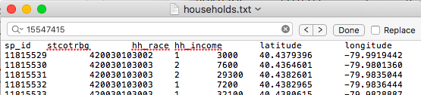
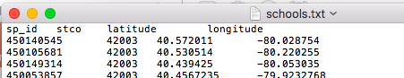
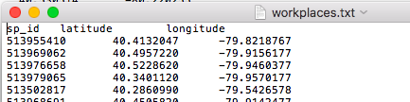
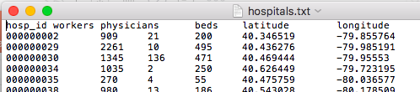
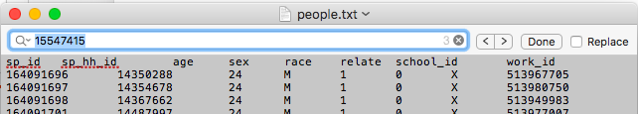
Suppose you wanted to quickly build a PRAM for Allegheny County
sites
groups
A machine could read these tables and build one agent per person and one site per school, household, hospital or workplace. However, for good reasons, PRAM works with groups, not individuals.

